Slide 1
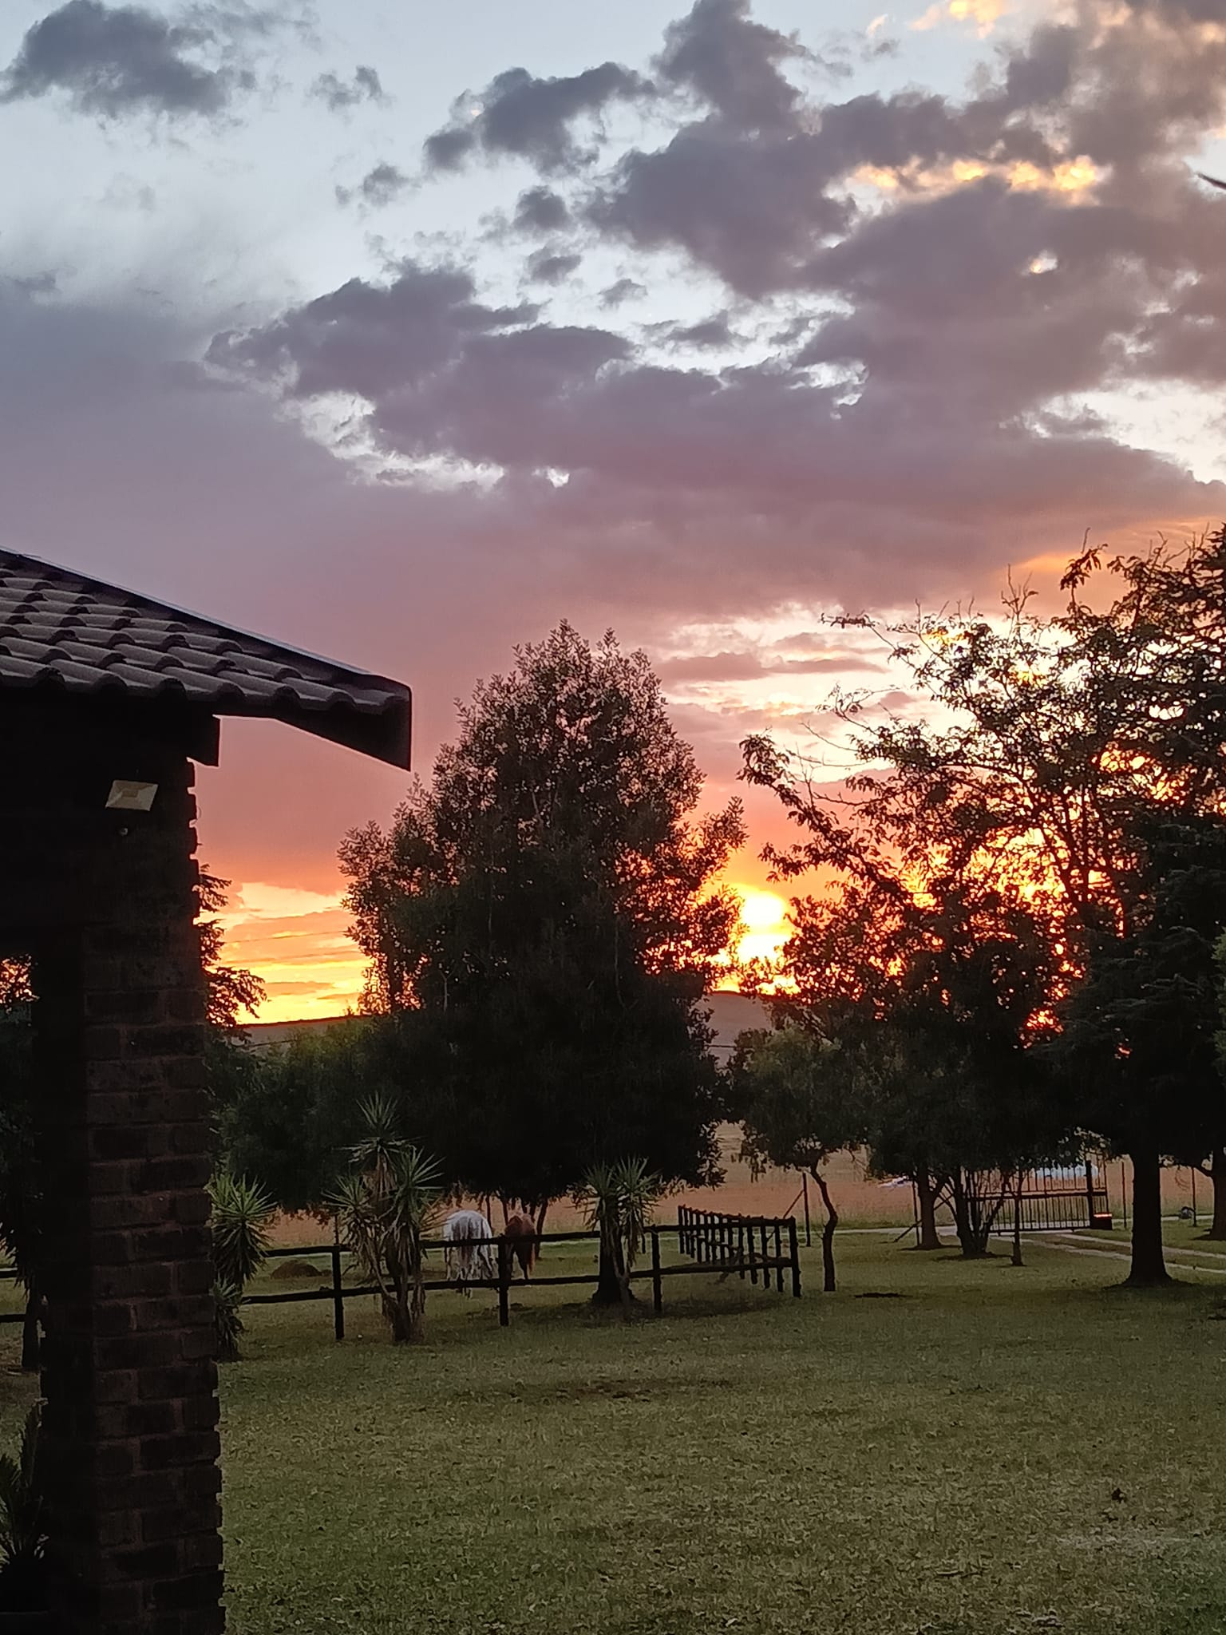
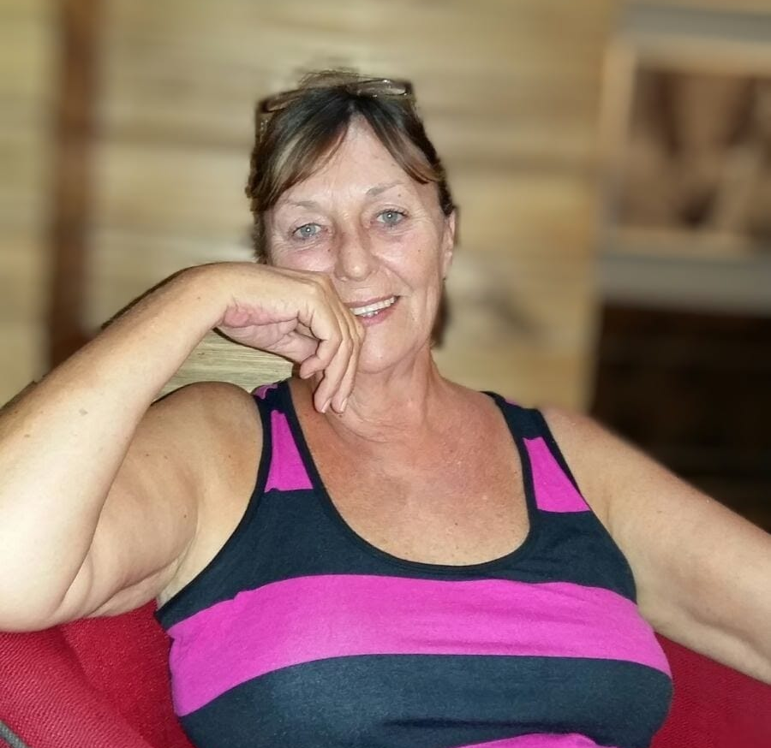


In Loving Memory of
JANINE ANN FRITZ
“Jonty Ann”

Slide 2

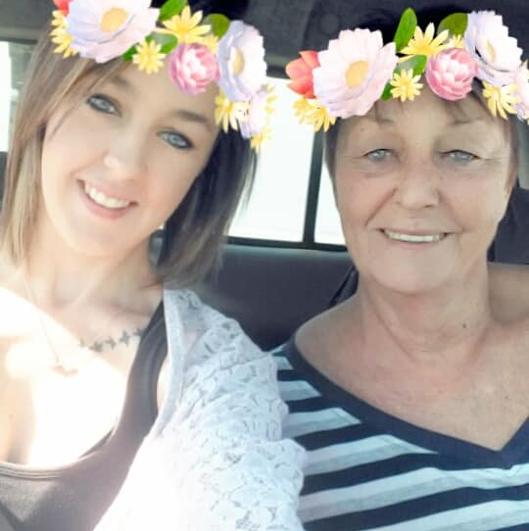

Introduction
HONORING
JANINE
Today, we gather to celebrate the life of Janine. As we reflect on the memories and moments shared with her, we find solace in the memories that she has left behind.
They speak directly to the heart.

Slide 3
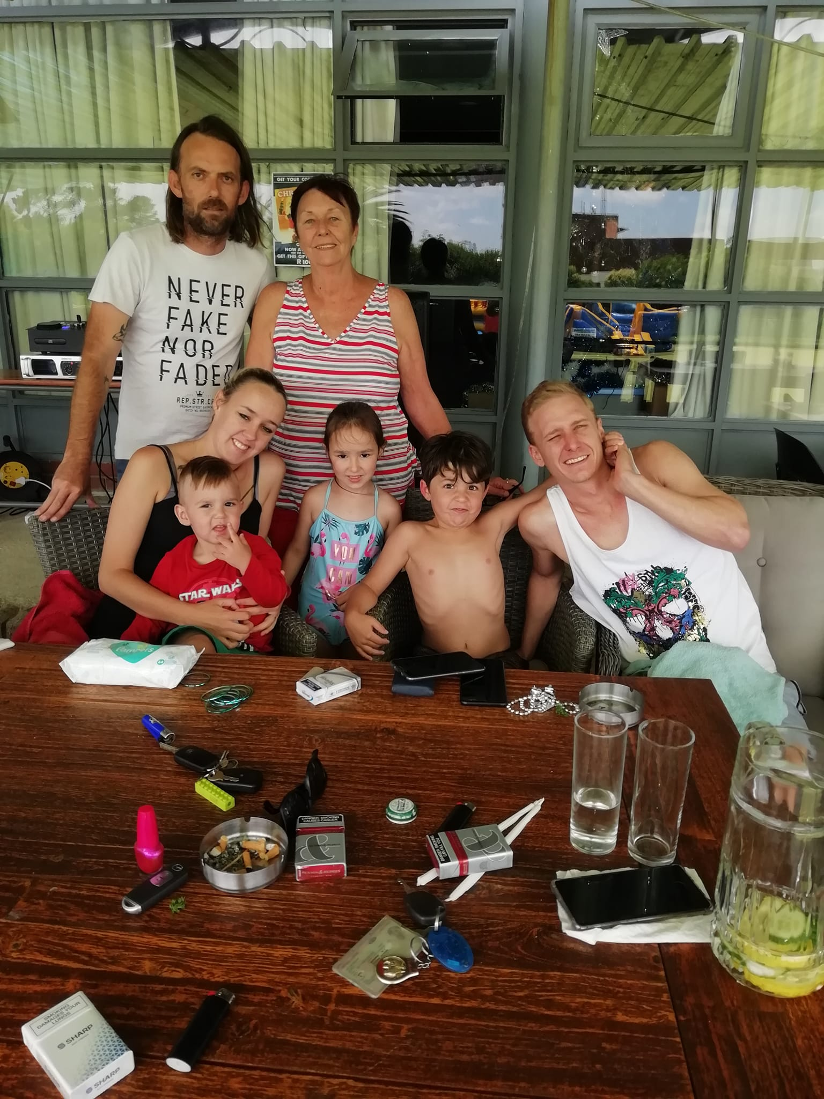
FOREVER YOUNG
And when you finally fly away
I'll be hoping that I served you well.
For all the wisdom of a lifetime No one can ever tell.

Slide 4
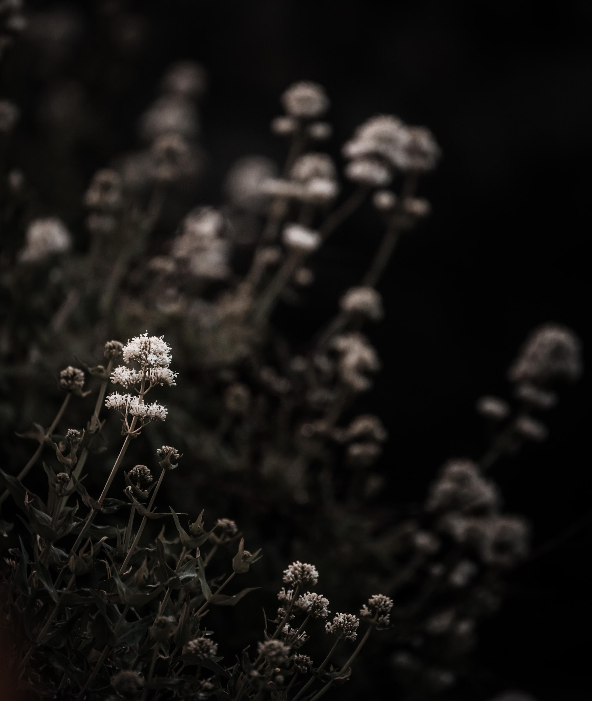
FAREWELL FROM YOUR FAMILY

Slide 5
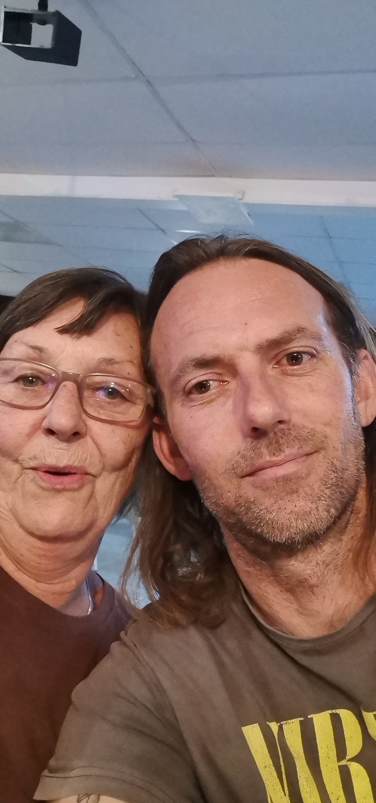
We could allow the grief to bury us alive. Just let the loss of you crush whatever’s left of us. But you’re not a memory, you’re a light still shining. Burning bright, and something we carry with us.
When we'll speak of you,
We'll do so with love.
We'll beam with pride.
We'll speak of your exuberance.
We'll give them your energy.
We'll tell them you were family embodied.
Dancing avant-garde, bold and beautiful.
Where you went, sunshine followed.
We'll tell them that you made life musical.
Every smile, a song.
Every laugh, a celebration.
Your life, your light, changed us in the greatest of ways. All the love shared between us doesn’t cease simply because you’re not beside us.
You’re within us.
Our skin and bones.
Our heart and soul.
The air we breathe.
The sun we stand beneath.
You are all around.
You are everything that made us.
And that sort of light never fades.
We'll take all the love we shared and continue sharing it.
MOM JAN
Loving you always.

Slide 6
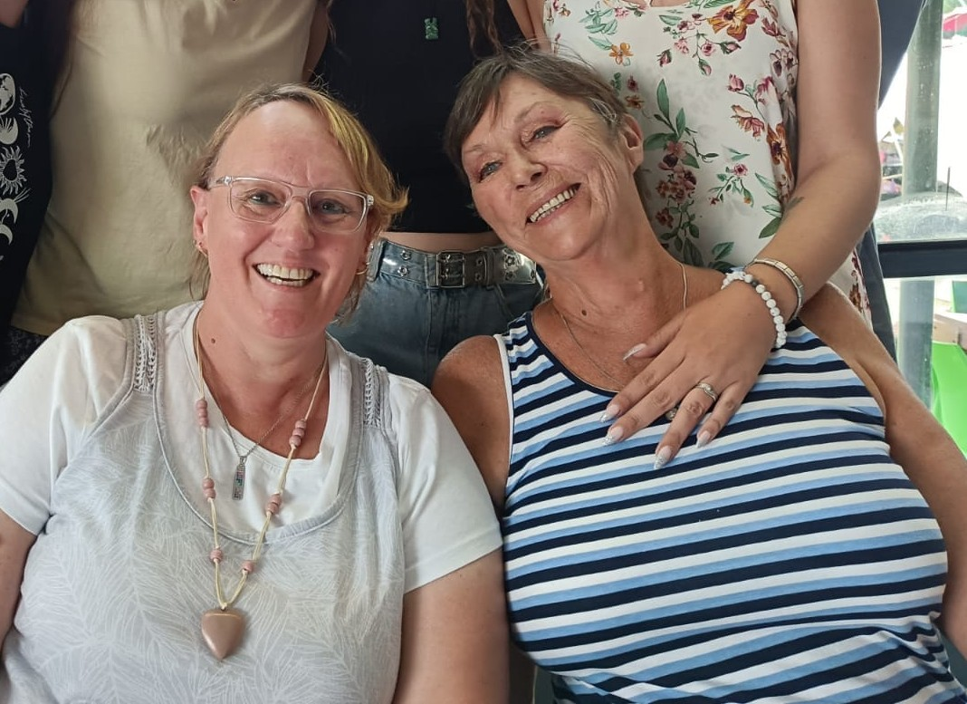
CHERISHED MEMORIES
Our darling and special Aunty Jan, yes, that is what you know we always called you.
The universe has come to fetch our Angel. What has happened here is incomprehensible, our lives will most definitely never ever be the same again.
It’s normally always “You” doing these Eulogies, so for us to be doing this for “You” just can’t be real.
Although are hearts are filled with grief, we are trying to hold onto all the Love, laughter and memories we shared with you, and you gave us and that certainly was in abundance.
You certainly were larger than life, your kindness, Love, wisdom, unwavering support will be with us forever and we thank you for just being “U”.
May you now rest with the Angels in eternal peace after such a terrible and hard struggle that you fought with such braveness.
We will love you forever and always.
Linda, Fred, Roland, Andrew and Jenna.

Slide 7
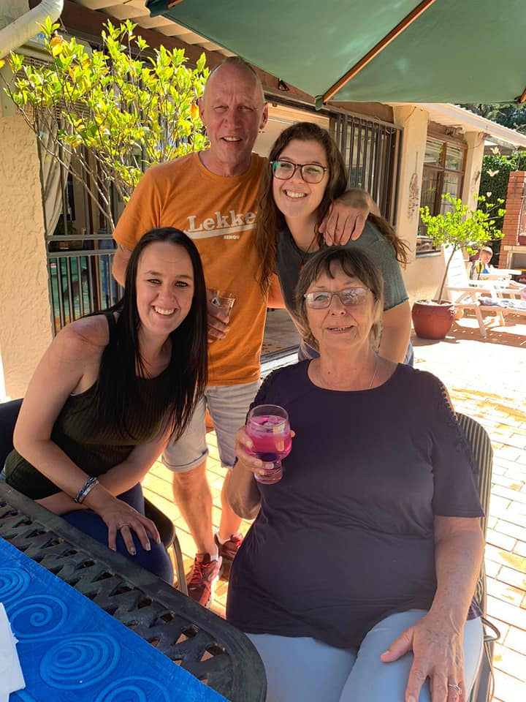
JONTY ANN
Our Beloved Aunty Jan. Jonty Ann, Aunty Bubup.
You are all of these to us and so much more.
Thank you for loving us the way you did.
Your beautiful soul and presence will be missed, though you will remain in our hearts forever.
We love you always - Dexter and Jayde.

Slide 8
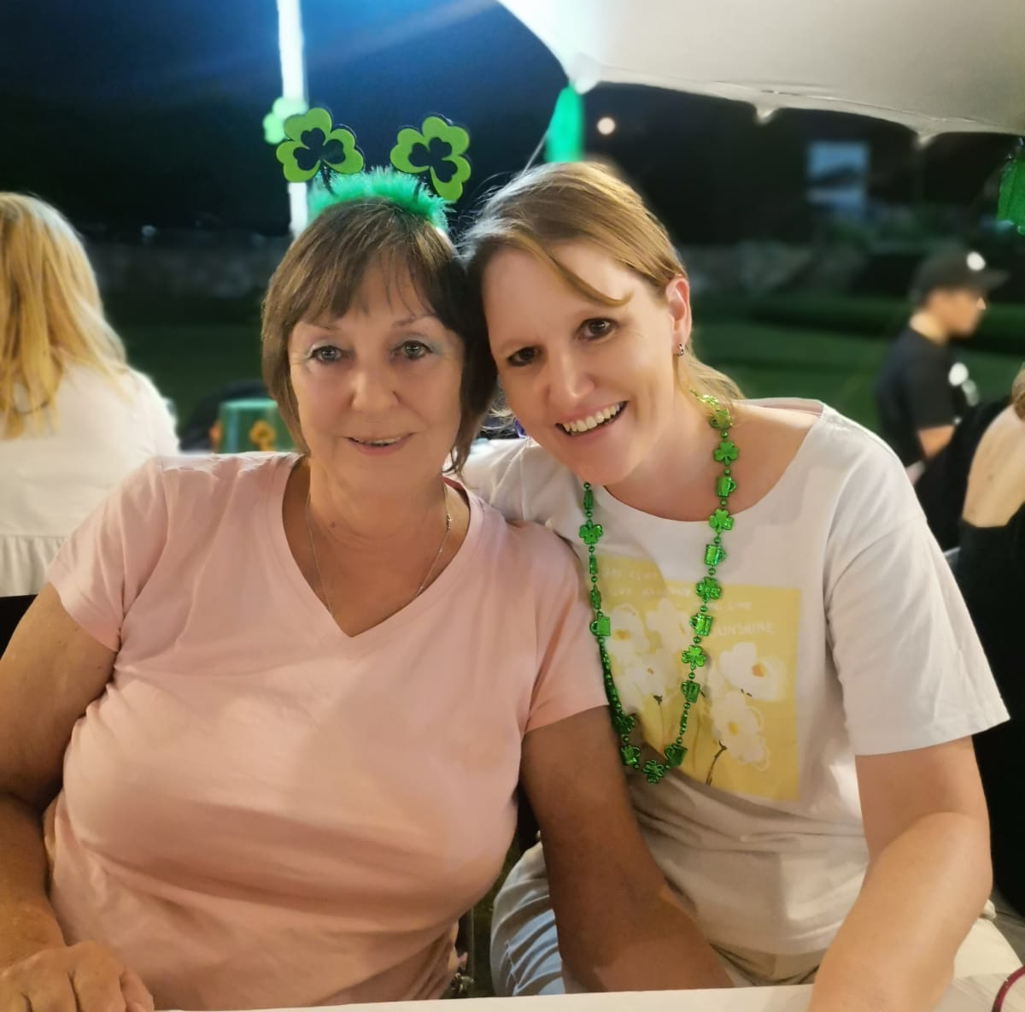
FOR OUR BELOVED AUNTY JAN
“A butterfly lights beside us like a sunbeam, and for a brief moment it’s glory and beauty
belongs to our world, but then it flies again. And though we wish it could have stayed, we feel so lucky to have seen it.”
Rest in peace our precious Aunty Jan. We cannot express our boundless love and thanks to you. We will be looking at all the beauty around us, and we will be seeing you…
We love you forever
Chris, Sandy, Sam and Adam.

Slide 9
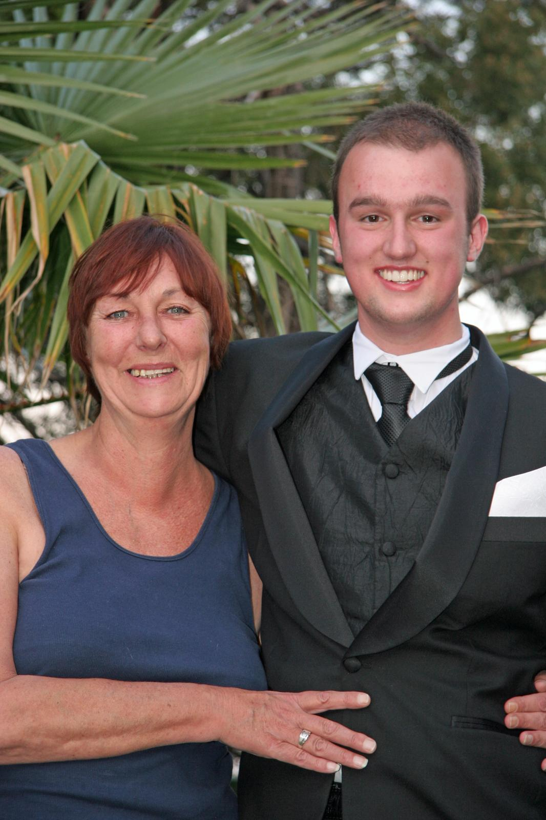
MY DEAREST AUNTY JAN
You have sailed out of a storm, and you now find yourself sailing across the vast plains of the ocean which are ever so still, calm and peaceful. We could never realize there was a storm because, as you have always done, you kept yourself composed and you kept us all sheltered. It is only now that you are sailing in a different direction that we begin to feel the rain pouring down on us.
Time will pass and so will this storm and when it does the night sky will be alight once again with the bright stars of our grand and ever-expanding universe. It is not easy though having to deal with the reality of echoed silence and locked communication, but I have to remind myself that although we are physically apart, rooted at the core of my heart is a key, a key of love, compassion and kindness that can unlock the pathway to you, and there I am able to share an abundance of memories with you which are filled with happiness, sadness, laughter and love-all the elements which make life beautiful, yet ever so fragile.
Aunty Jan, as you sail across these still waters you will see that reflecting at you is the woman who you have always been-a vivacious, charismatic, witty, loving and caring mother, grandmother, aunt and indeed one hell of a great aunt. As you see yourself in this reflection you will also be able to see that radiating behind you is a blanket of the night sky enriched and glowing with an abundance of stars. So, as you lift your head to look into the night sky just know that the stars you see are the same stars I see and even though we are physically apart and I must continue sailing in the physical realm of planet earth, knowing that we are always connected to shine light into one another soul brings me peace.
The time will come when I too need to return my energy back to mother nature and when that time comes, I know you will be there to guide me, but until then I will live by what you valued and to live life to the full. Thank you for everything Aunty Jan, you provided us with love and what remains is a complete and unified family. Until we unite again Aunty Jan I love and will always love you!
Your dearest Roles/Poles

Slide 10
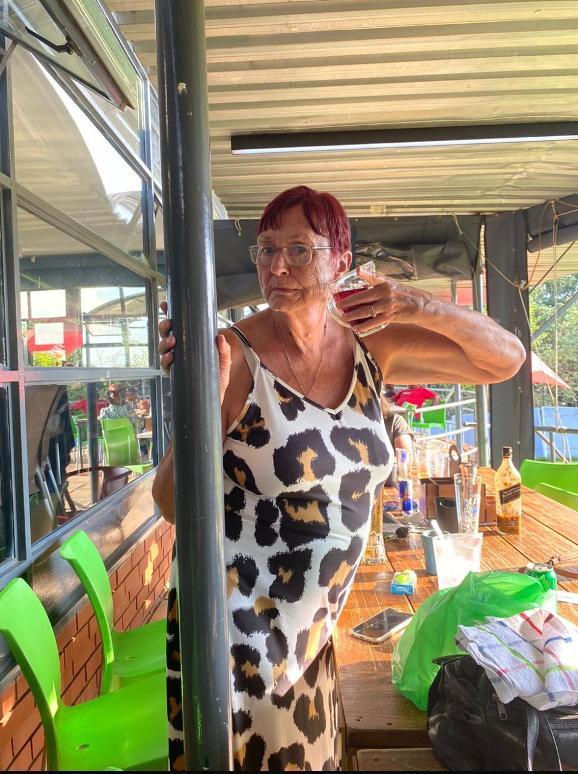
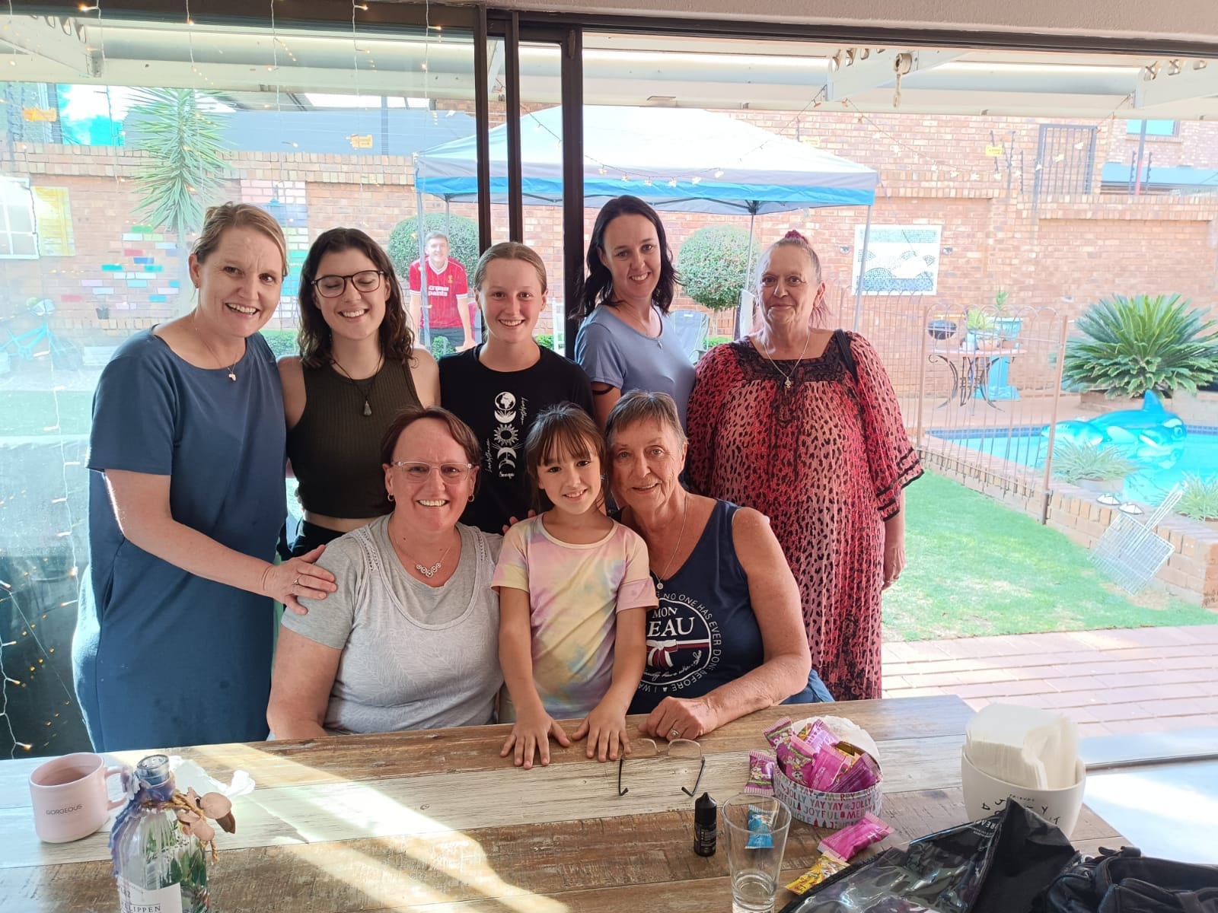
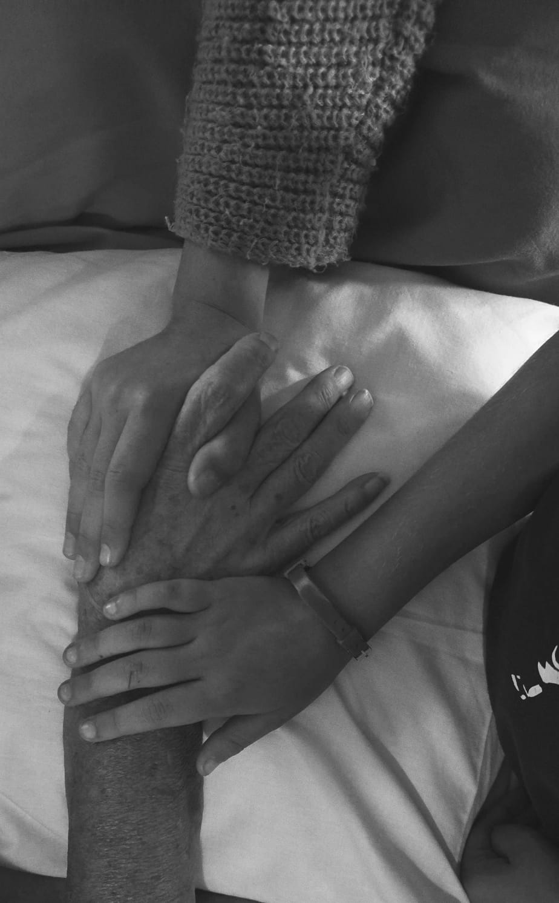
FINDING COMFORT IN REMEMBRANCE
In times of loss, it's natural to seek solace in memories. Let us take a moment to reflect on the special moments we shared with Janine. Through laughter and tears, their spirit remains alive in our hearts, guiding us with love and strength.
May Sunshine and Happiness Surround You When You Are Far From Home

Slide 11
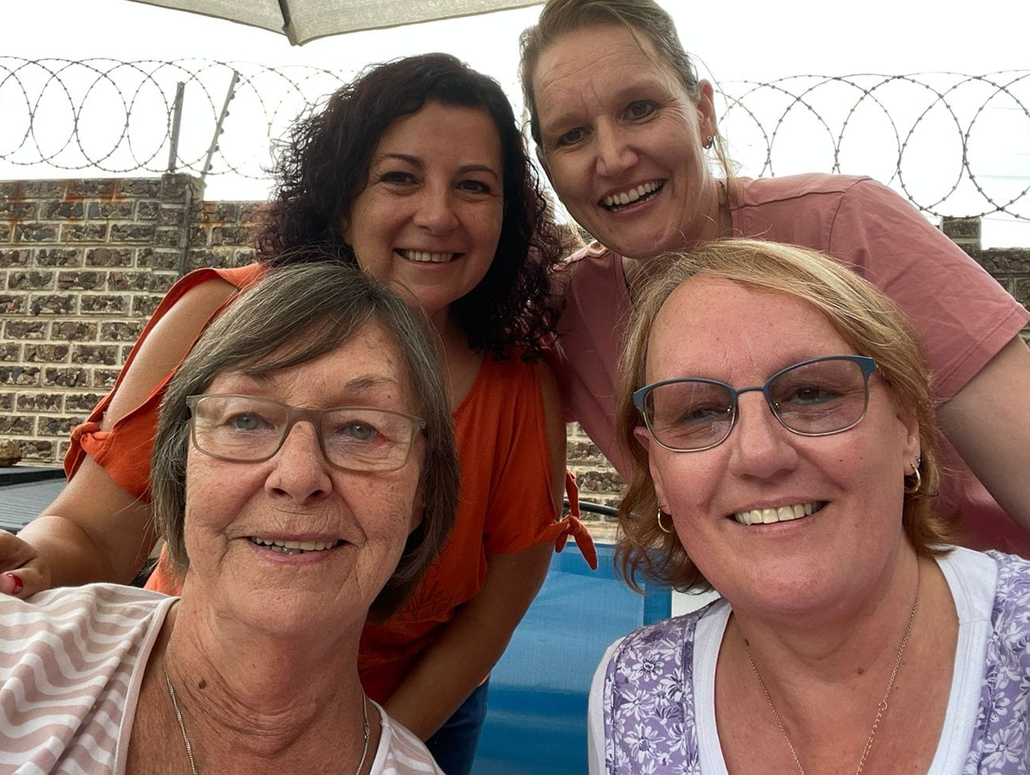
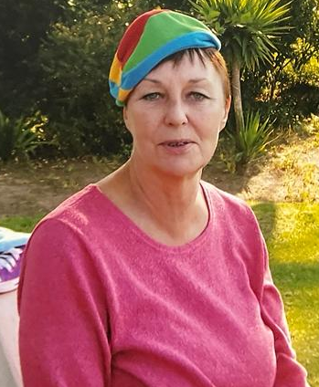
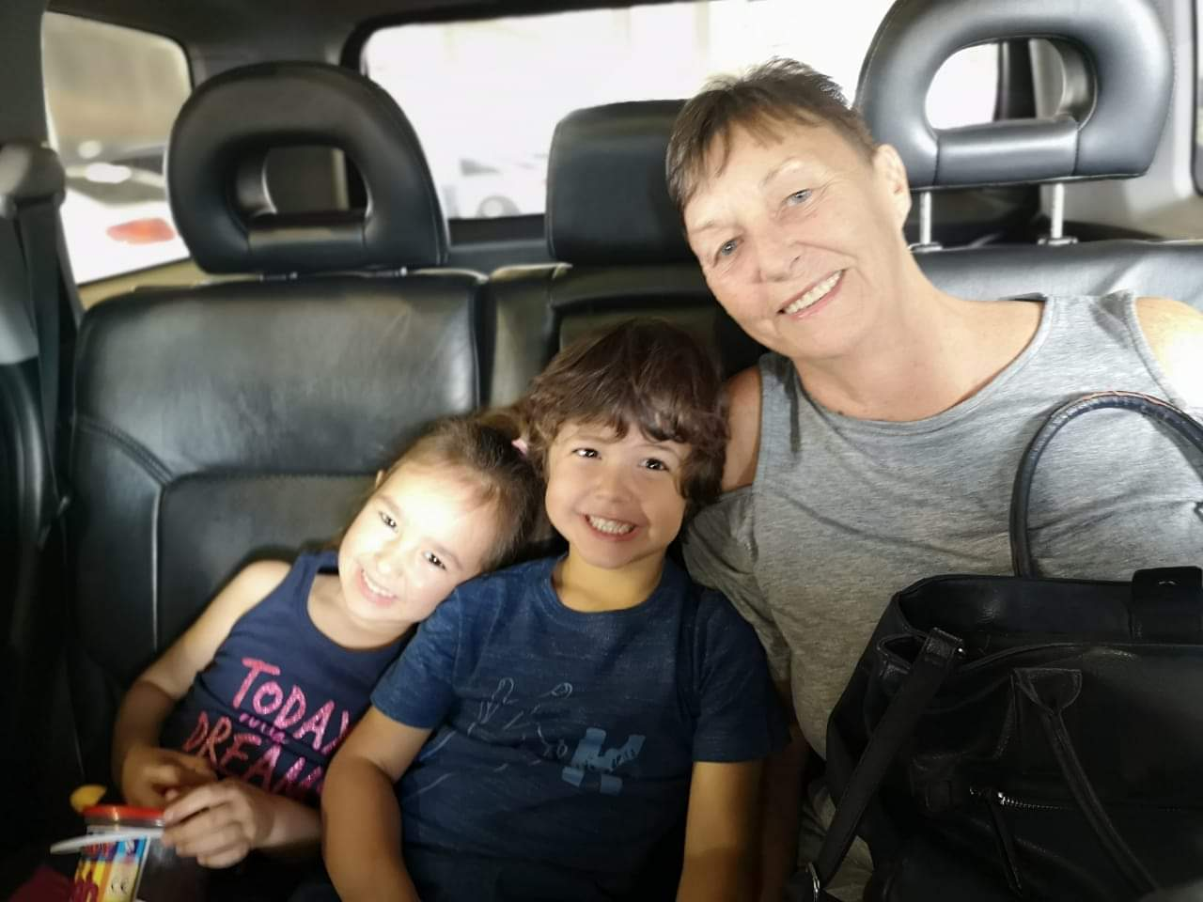
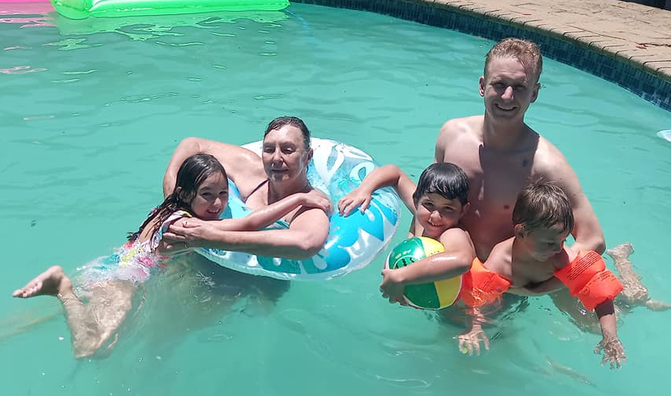
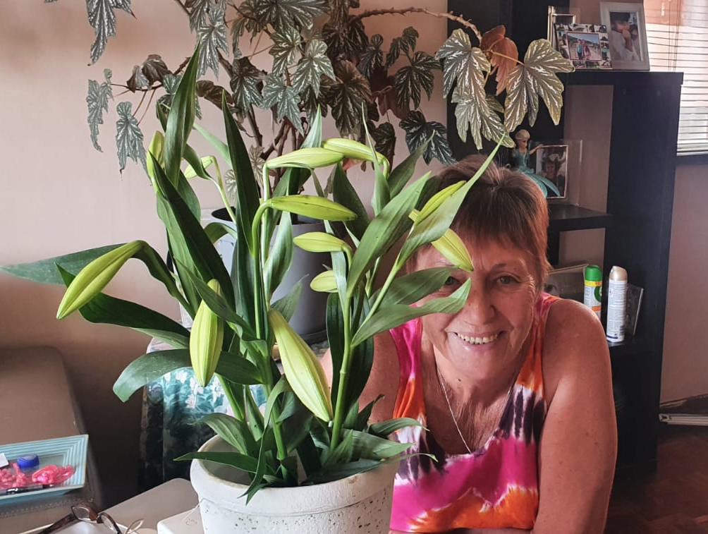
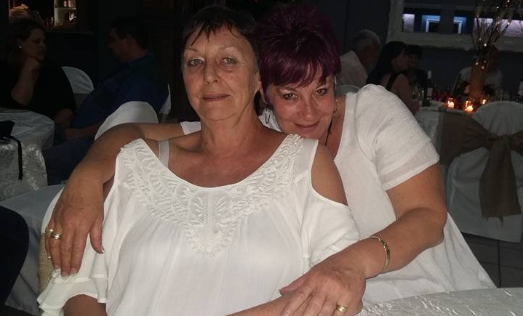
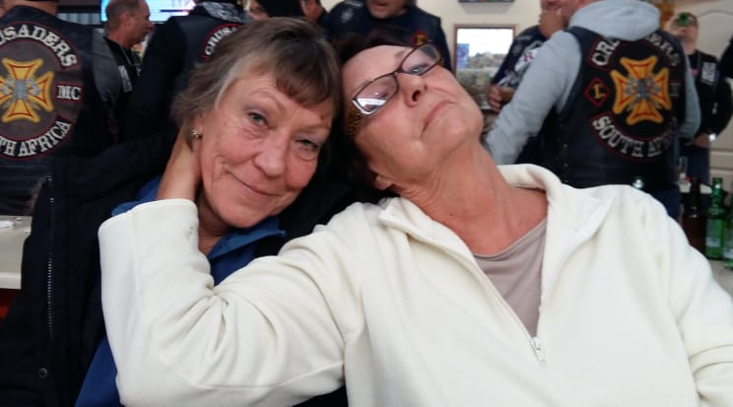
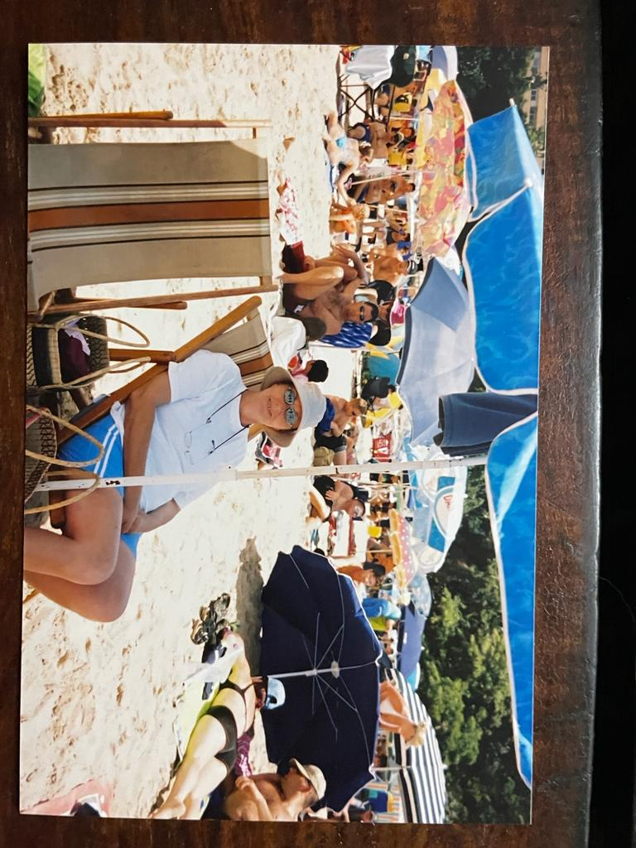
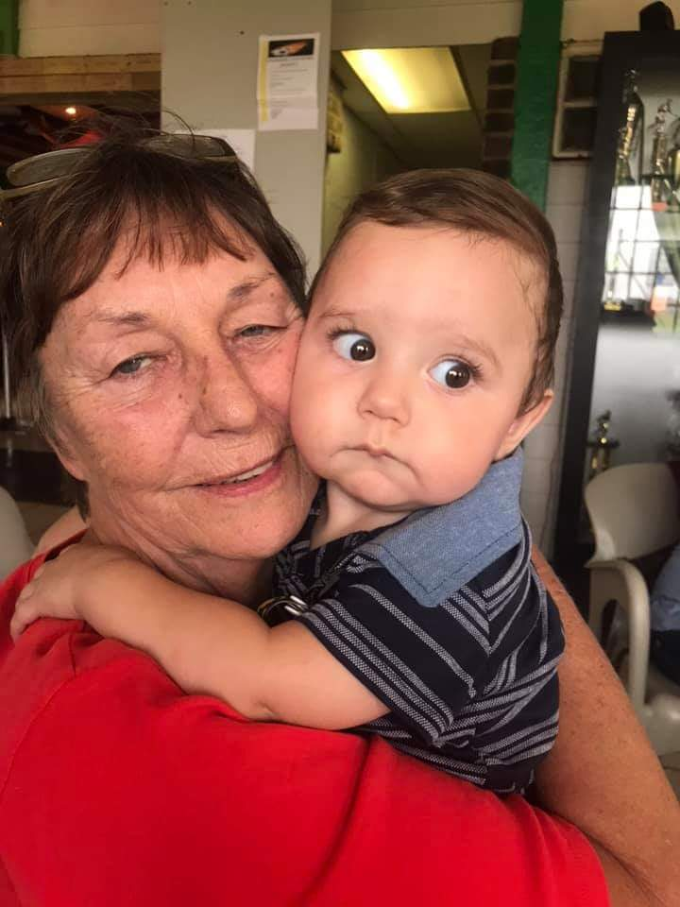
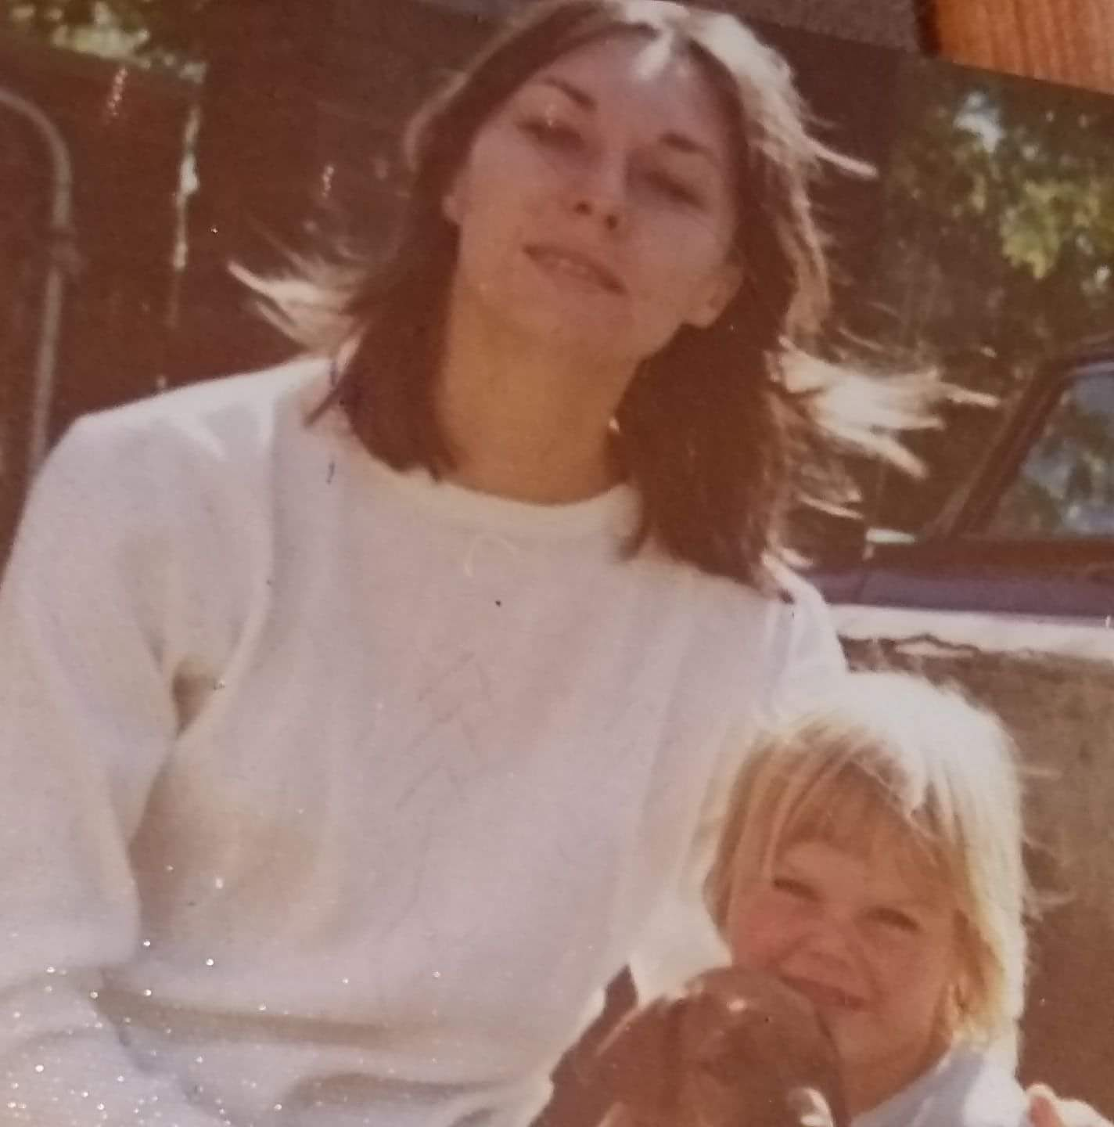
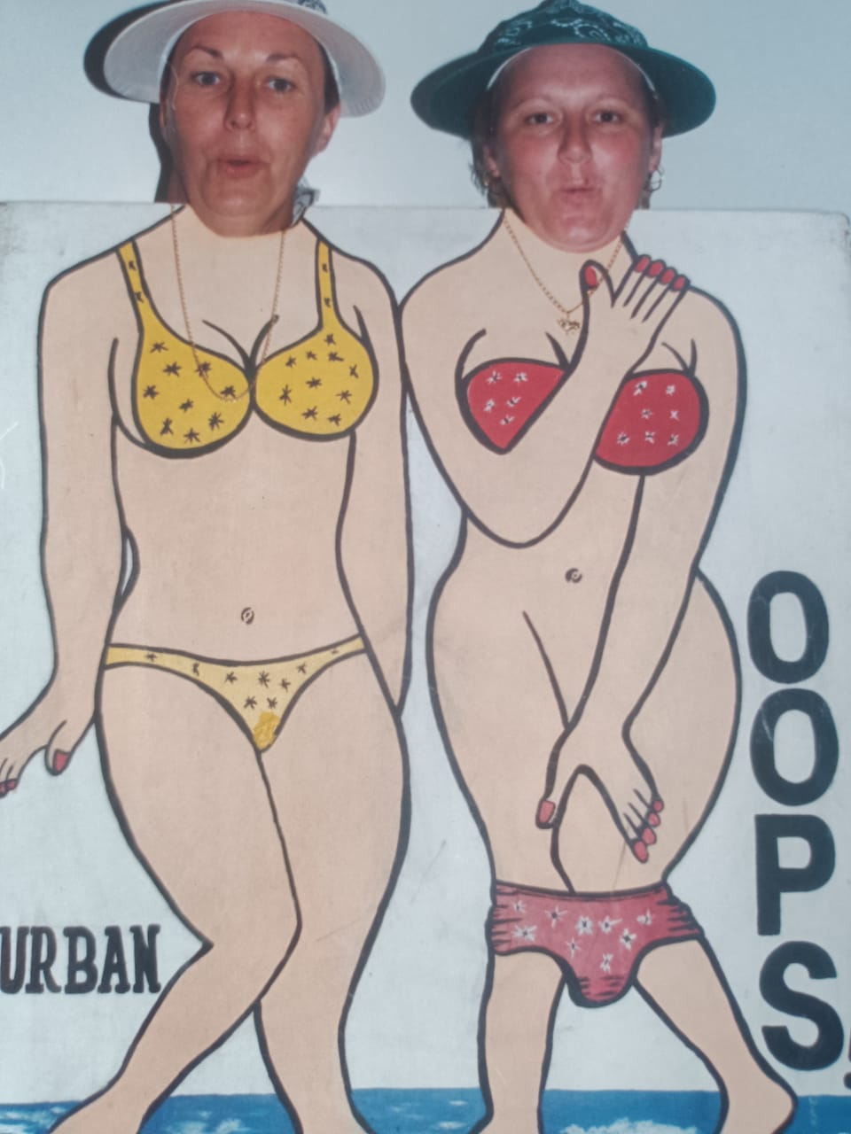
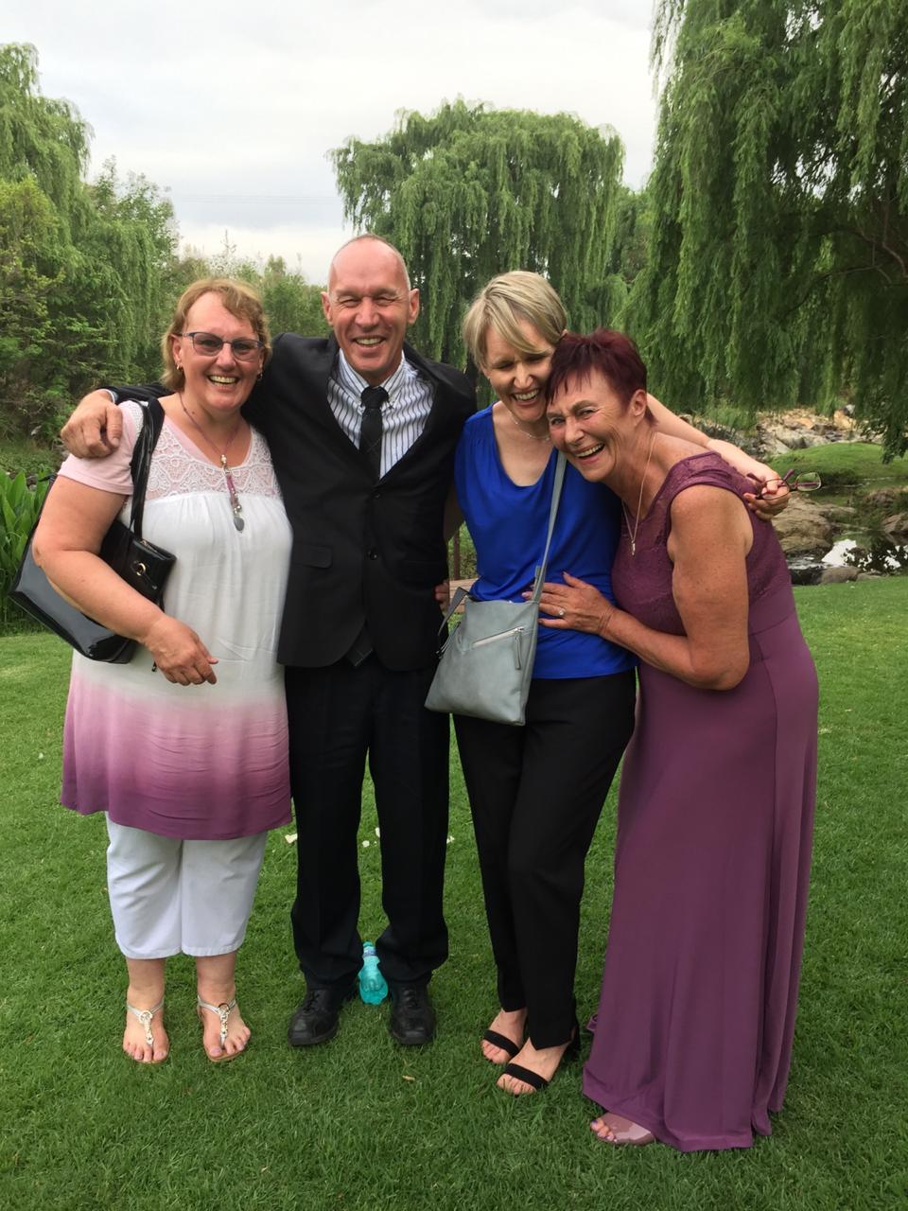
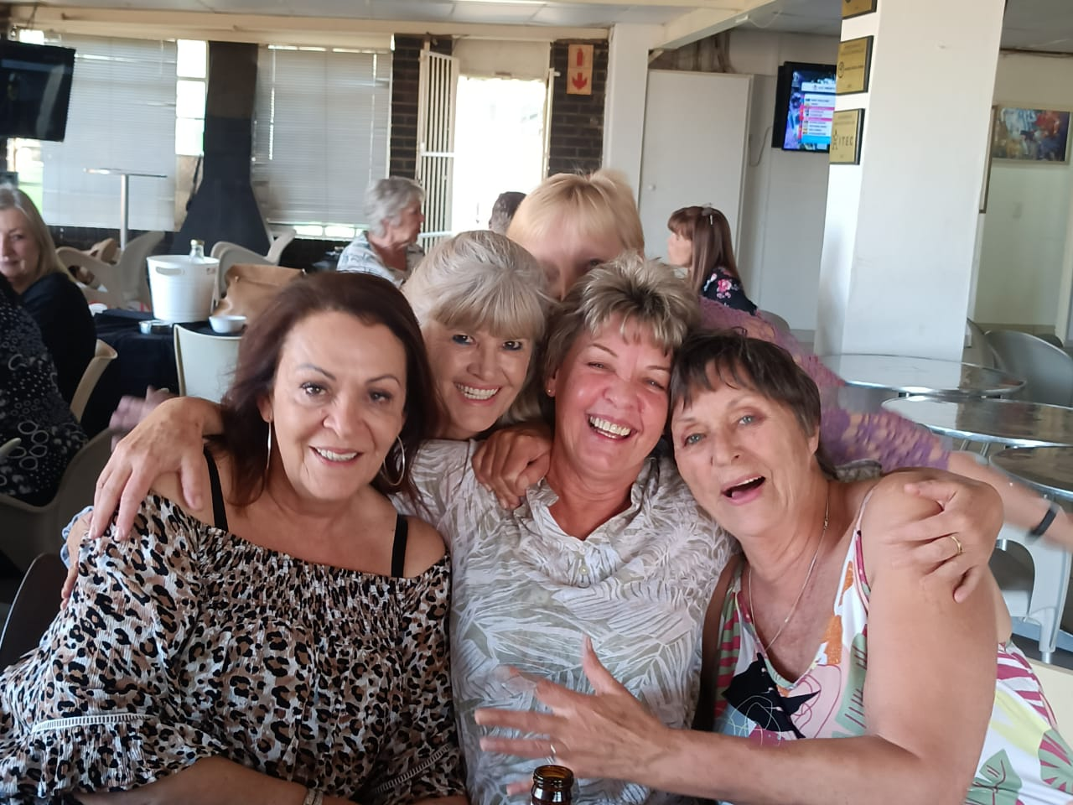
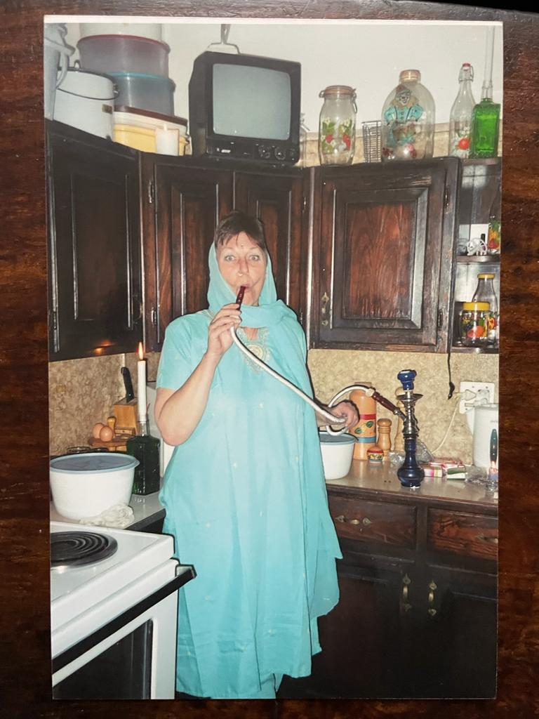
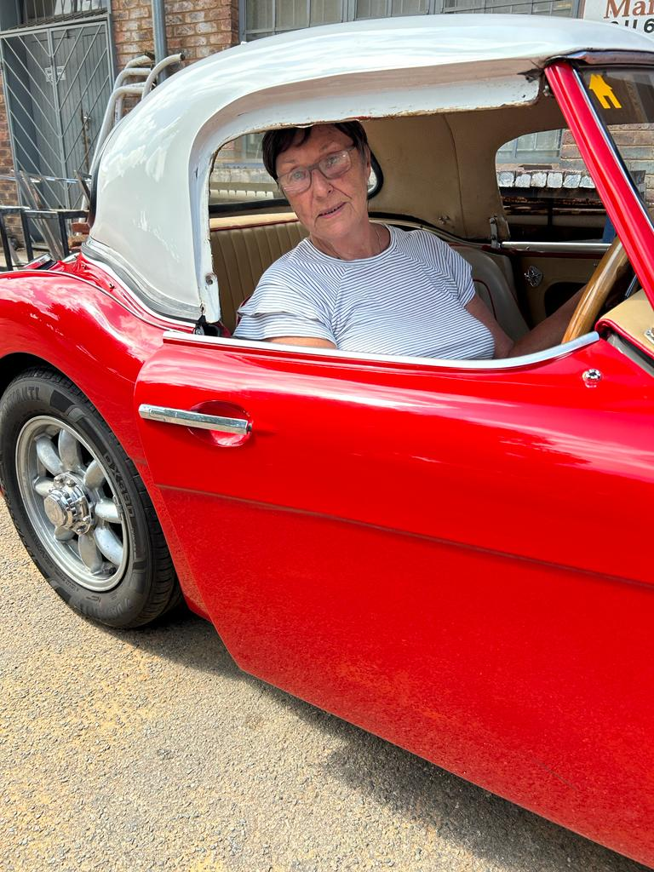
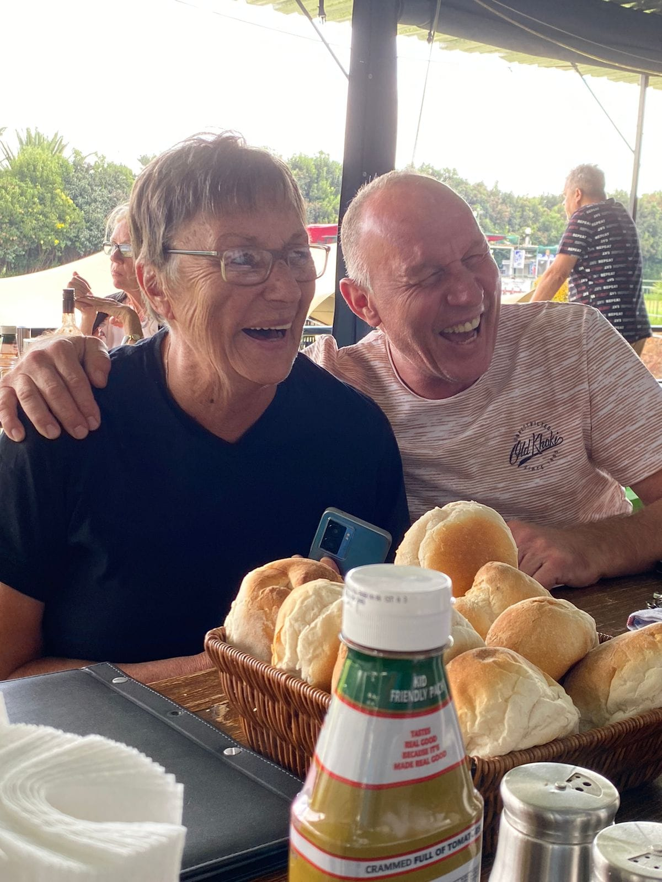
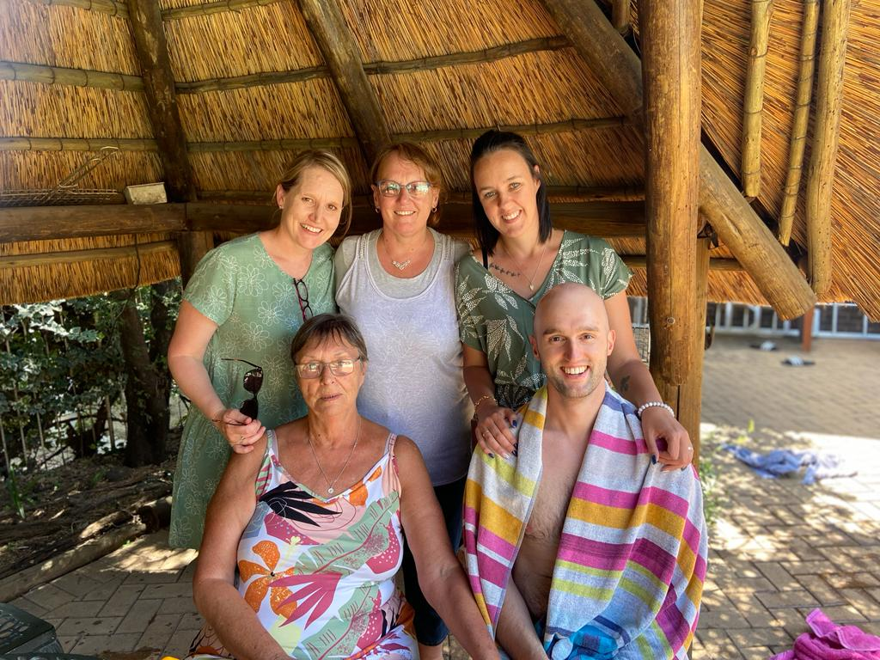
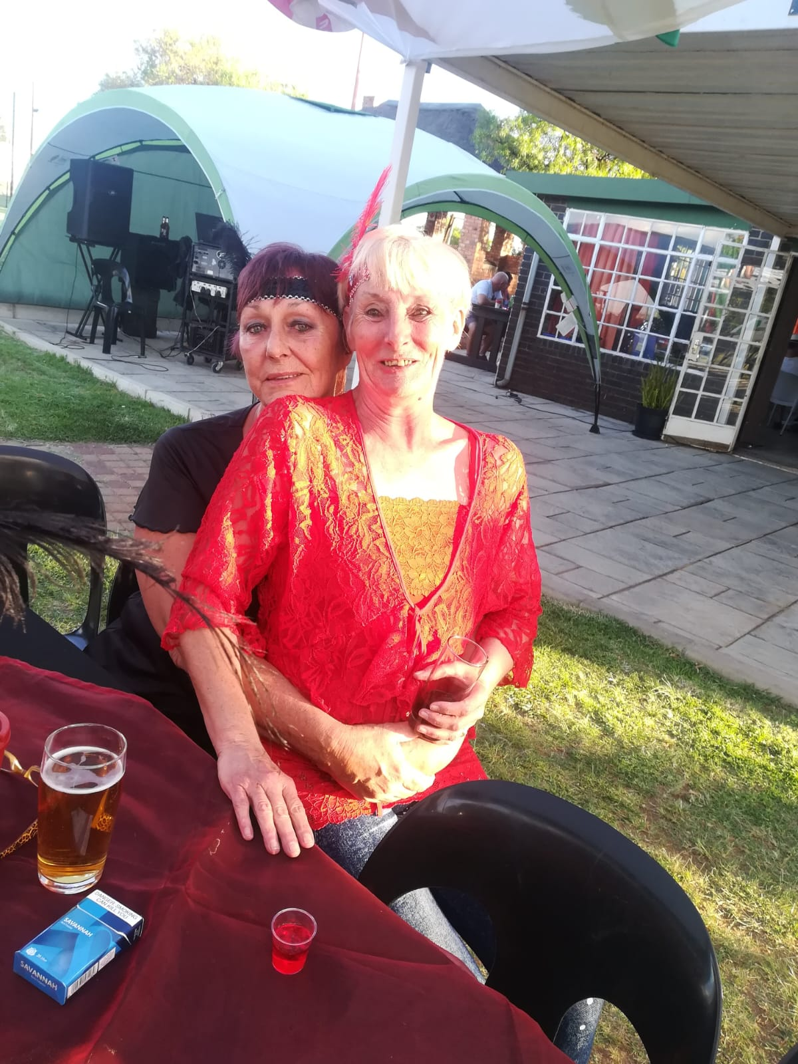
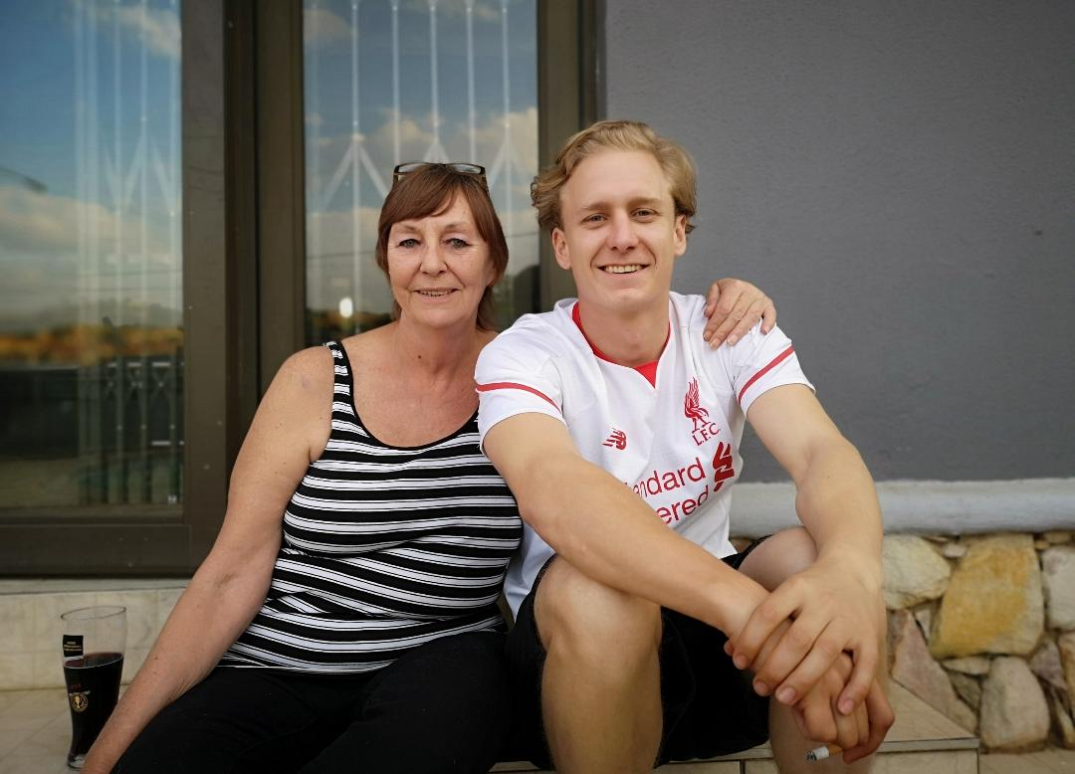
LEGACY OF LOVE

Slide 12
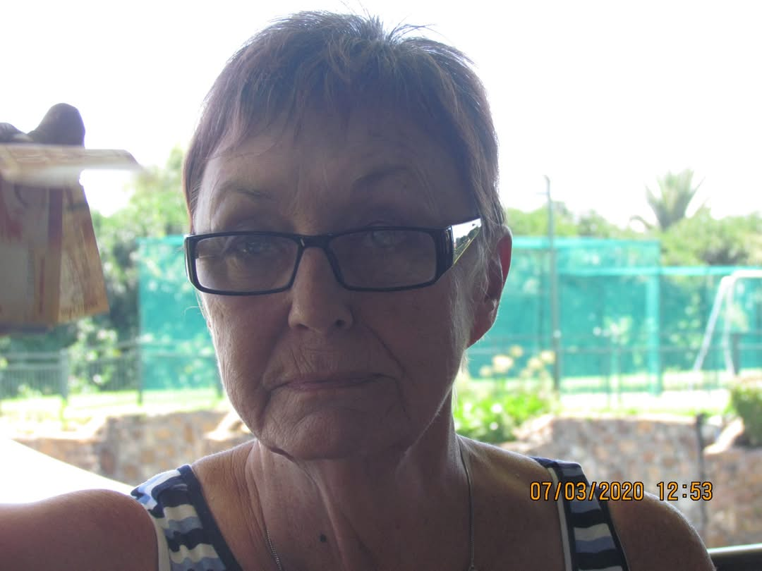
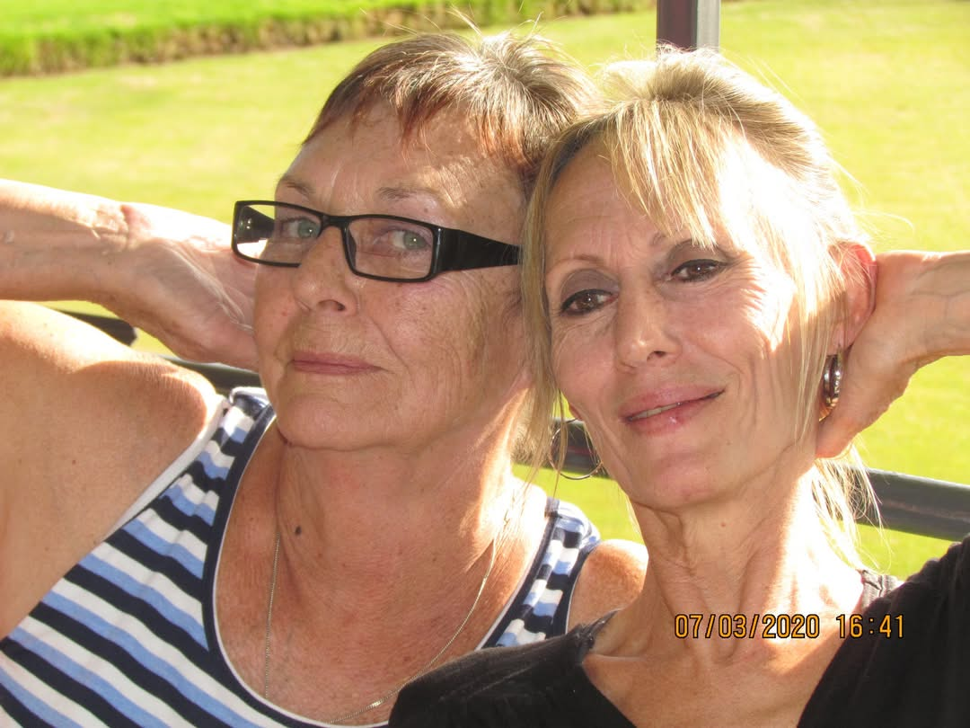
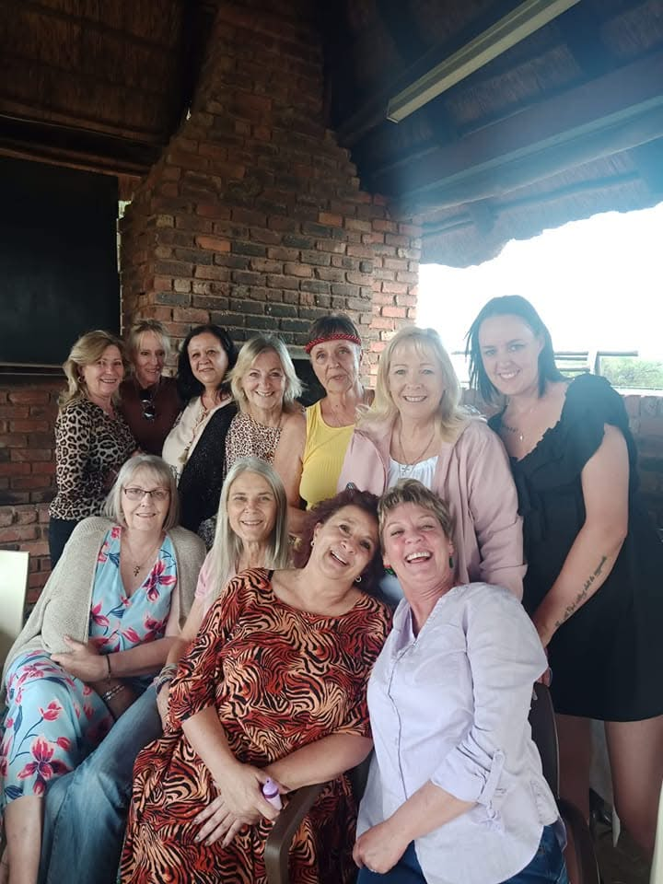
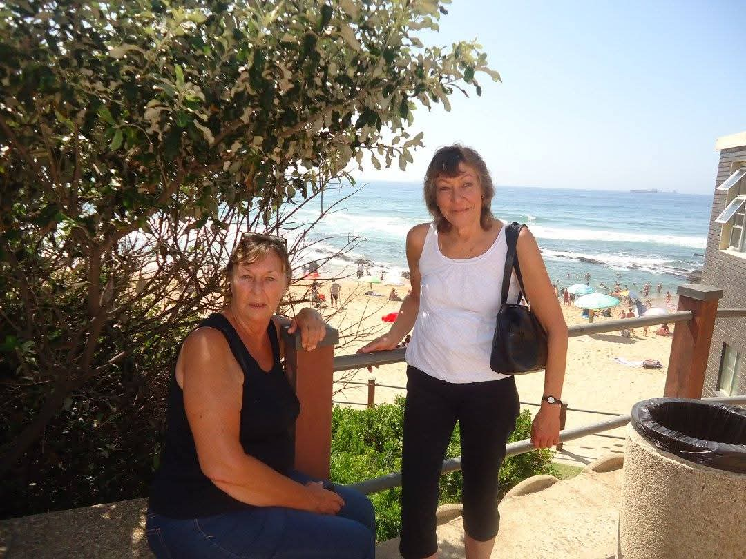
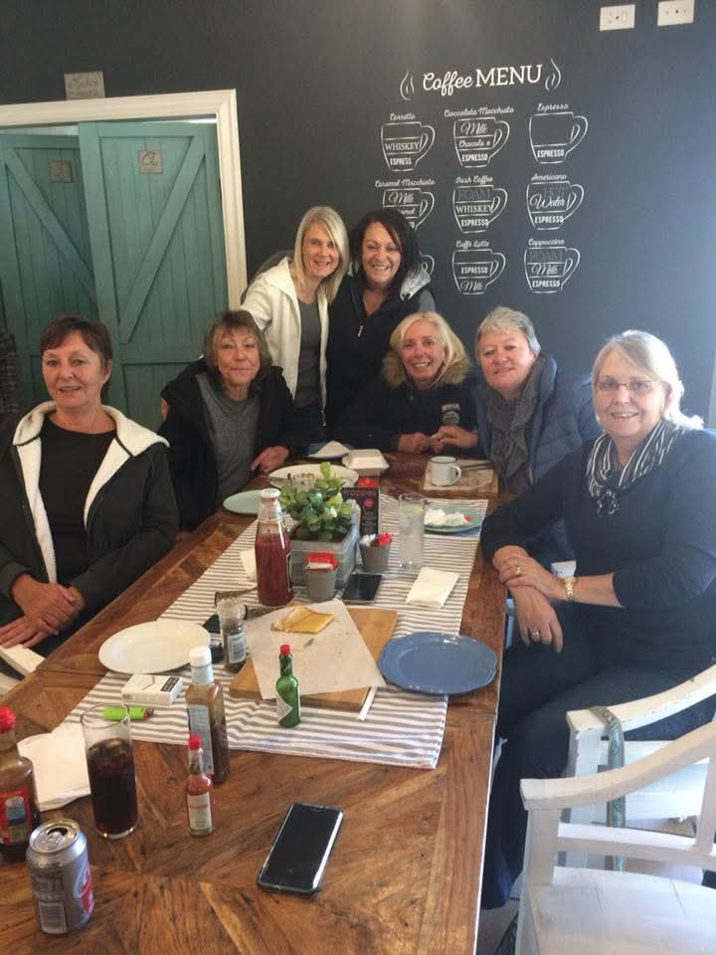
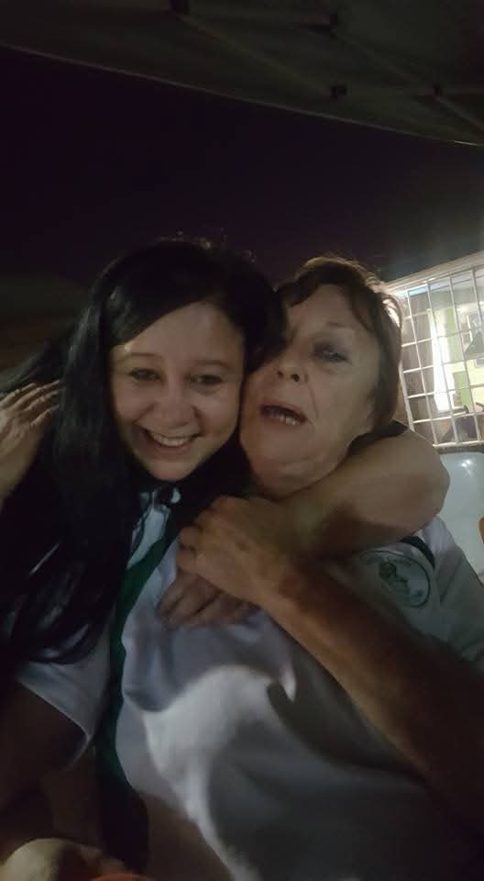
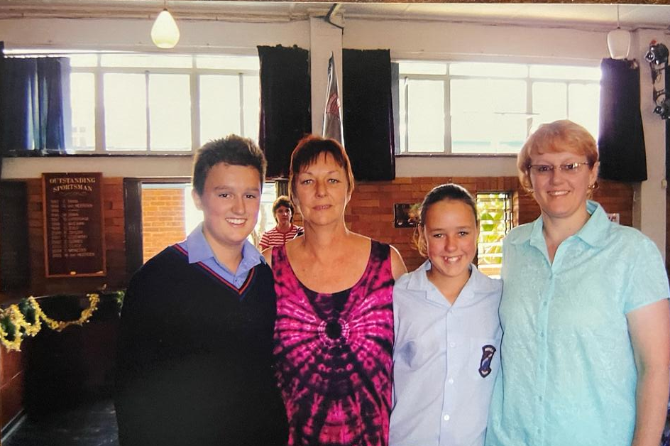
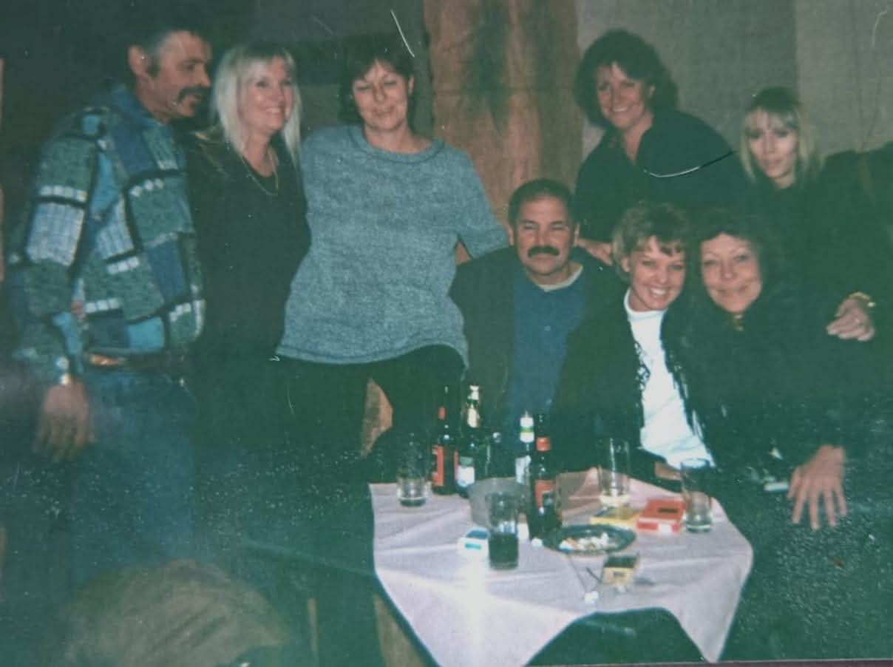
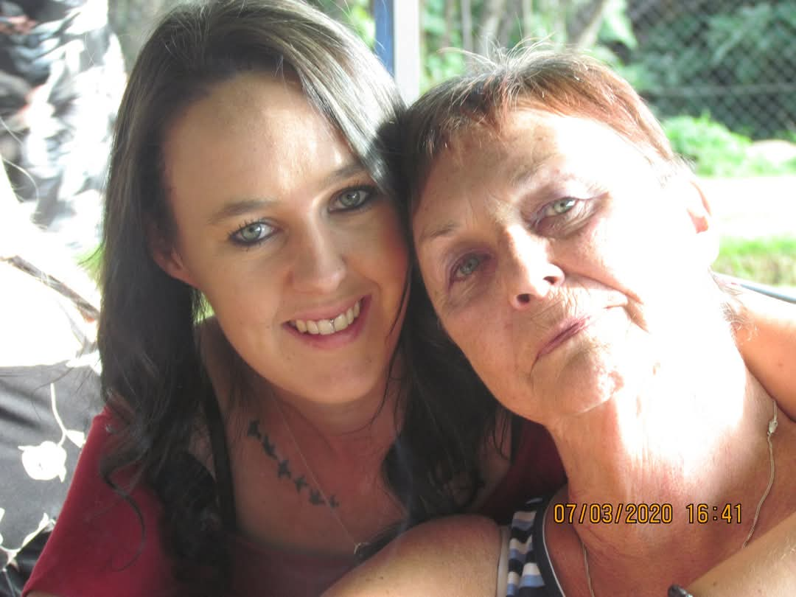
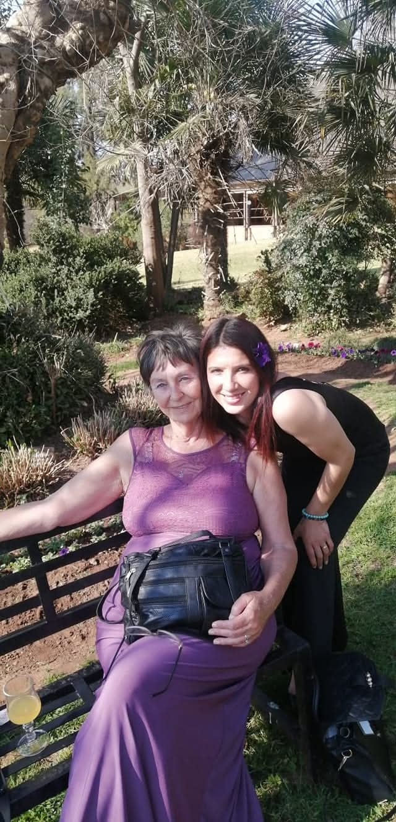
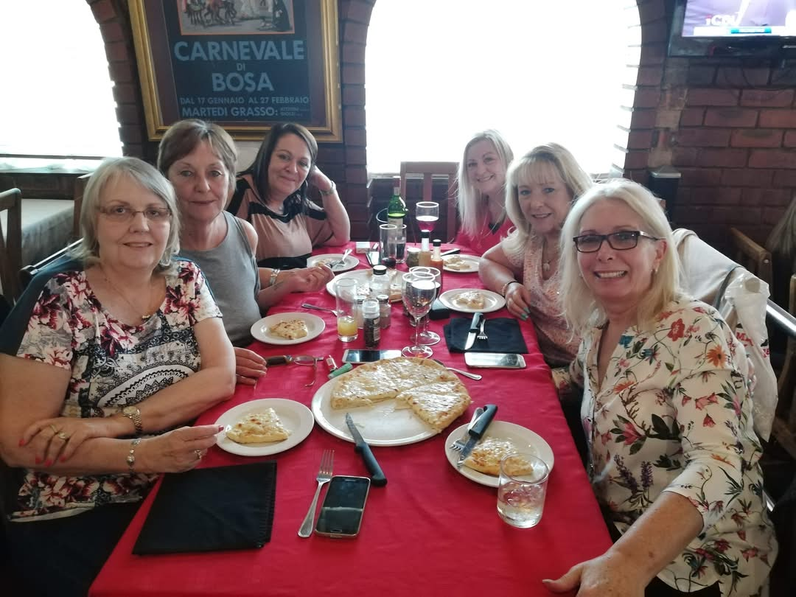
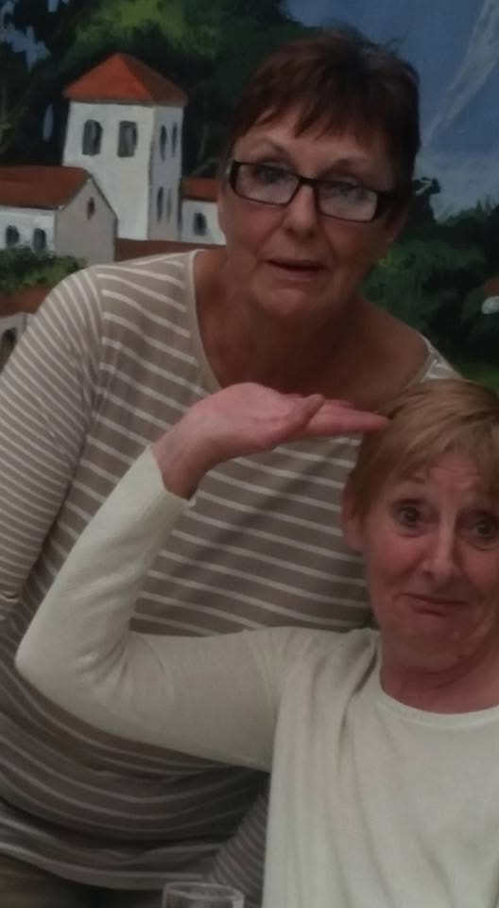
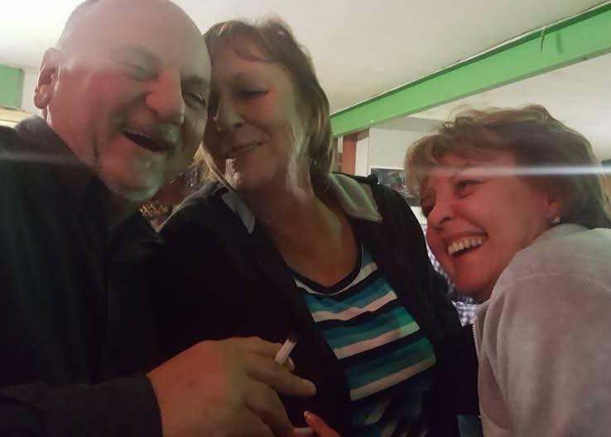
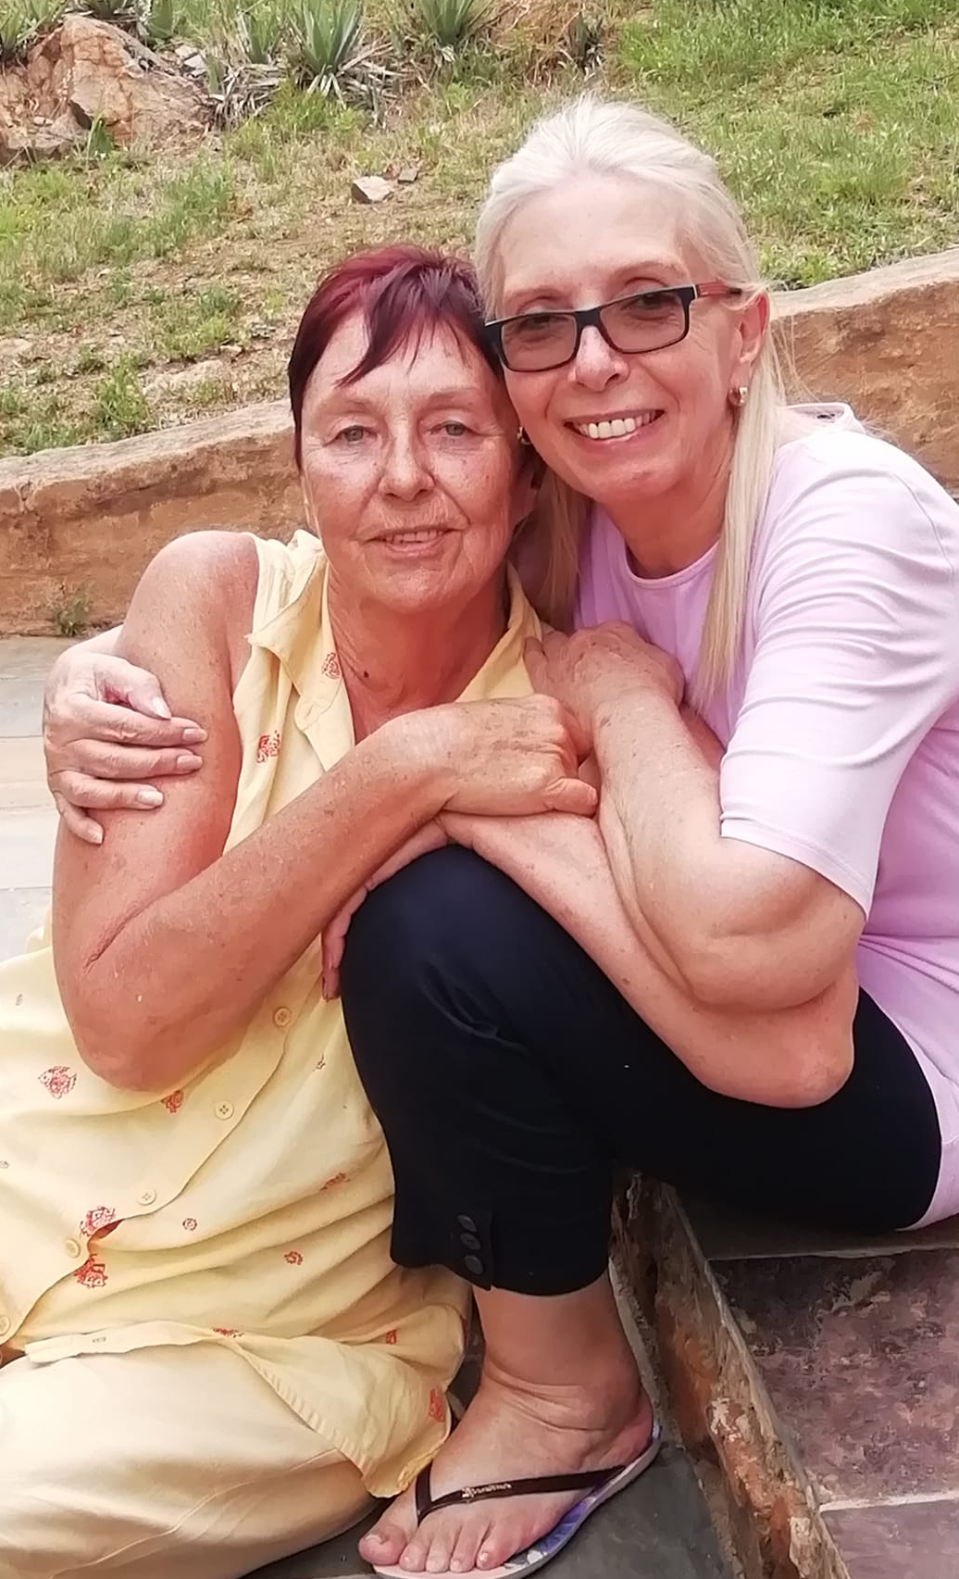
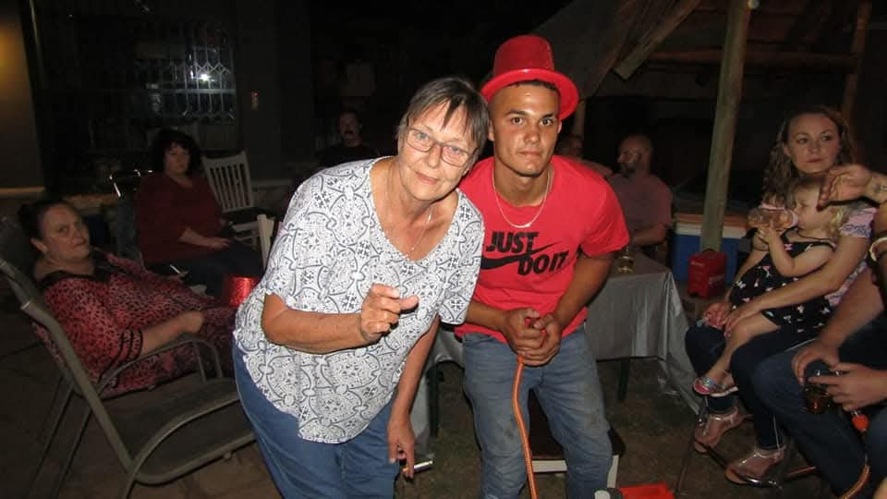
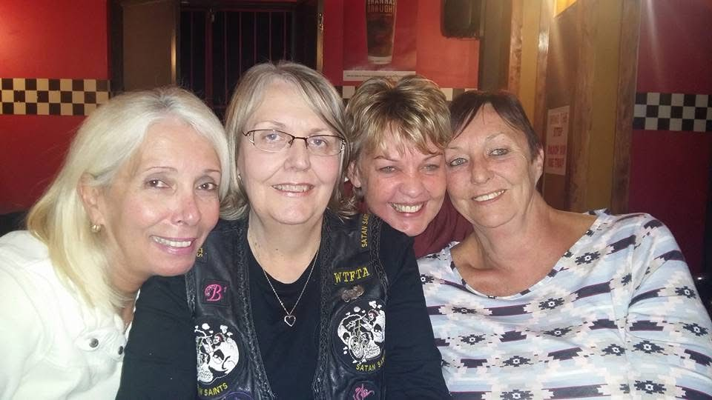
LEGACY OF LOVE

Slide 13
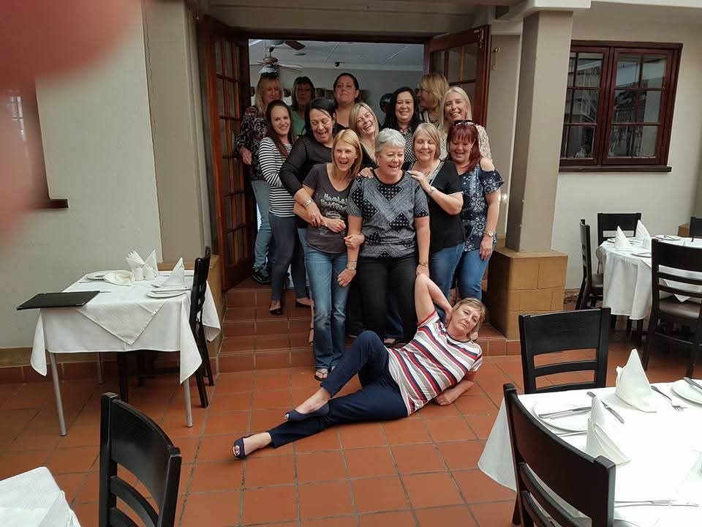
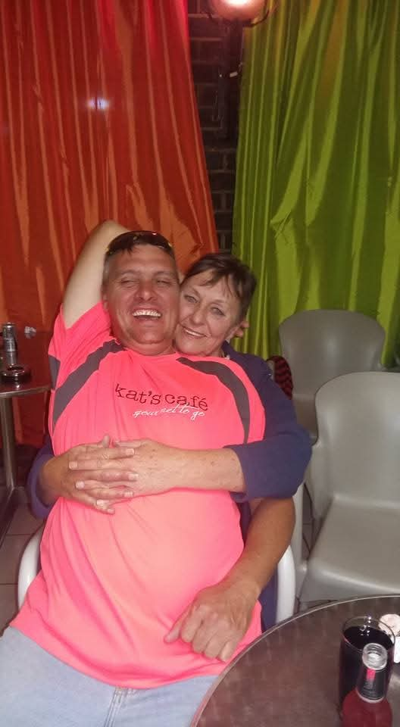

















LEGACY OF LOVE

Slide 14

















LEGACY OF LOVE

Slide 15

WORDS OF COMFORT
“And now, the end is here. And so, she faced the final curtain. Friends, she said it clear. She stated her case, of which she was certain. She lived a life that was full. She travelled each and every highway. And more, much more than this, she did it her way.”
Amen.

